Slide 1

ZAS Robotic Products
Navigational Robotic Series
Robot Car-3 (Advanced Autonomy)
GPS Satellite-Based Position and Time Estimation

Slide 2
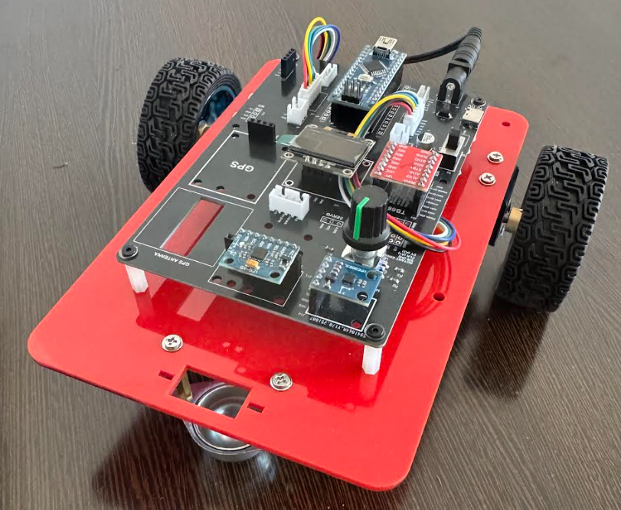
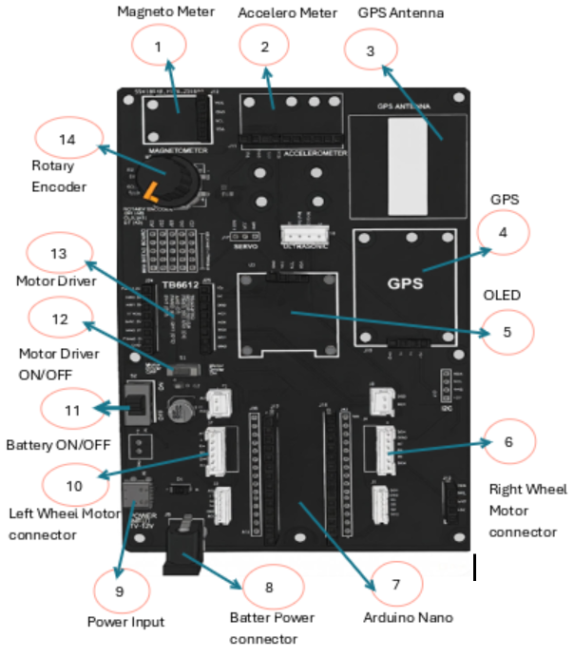
GPS Satellite-Based Position and Time Estimation
Robot Car-1 - Assembled view and Creative Board component layout

Slide 3
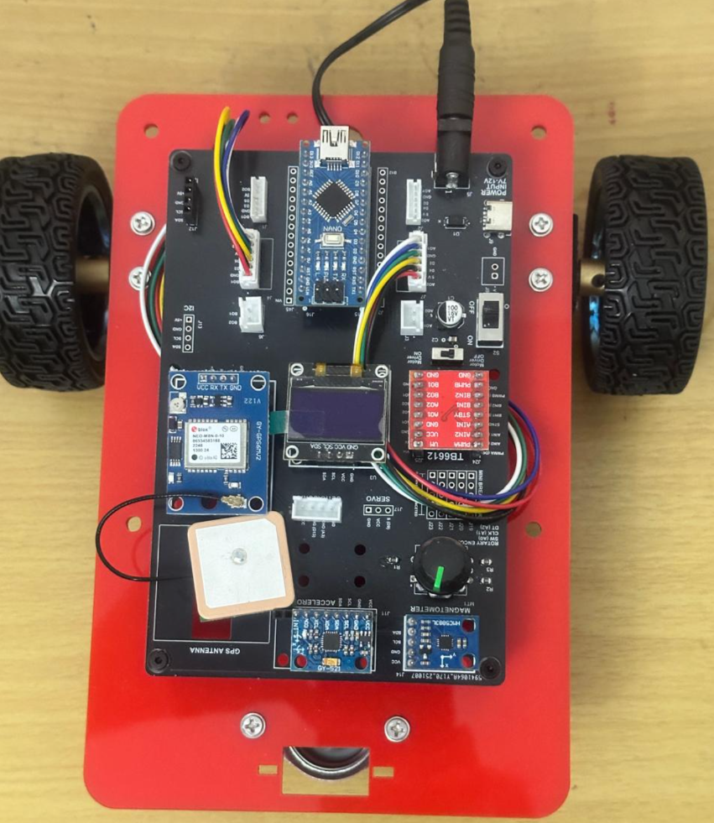
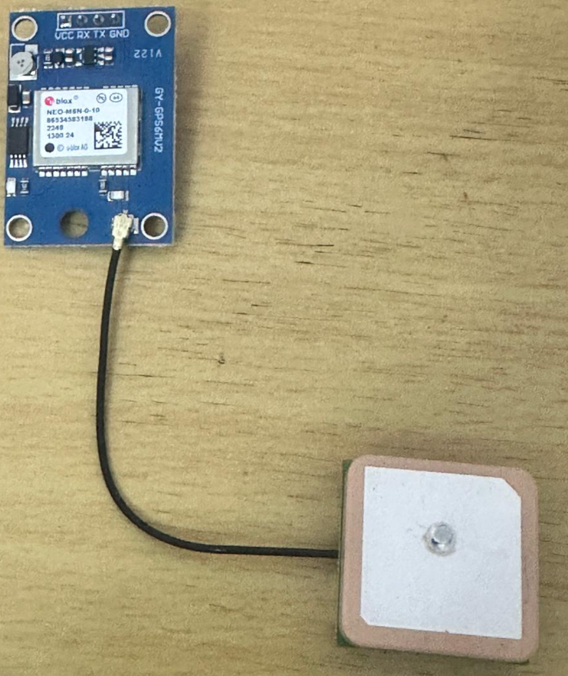
GPS Satellite-Based Position and Time Estimation
GPS & GPS Antenna mounter on Robot Car-3

Slide 4
GPS Satellite-Based Position and Time Estimation
Purpose
This experiment demonstrates how a GPS receiver determines geographical position and time using satellite signals.
The experiment focuses on:
Satellite-based positioning principles
Real-time latitude and longitude estimation
GPS-provided date and UTC time
Practical considerations such as cold start delay and outdoor testing
This experiment establishes the first functional use of GPS data in the robotic platform.

Slide 5
GPS Satellite-Based Position and Time Estimation
Key Definitions
GPS (Global Positioning System) A satellite-based navigation system providing position and time information.
Latitude / Longitude Geographical coordinates representing a position on Earth.
GPS Fix A state in which the GPS receiver has successfully computed its position.
UTC Time Coordinated Universal Time provided by GPS satellites.
NMEA Sentences Standard text-based messages transmitted by GPS modules.

Slide 6
GPS Satellite-Based Position and Time Estimation
Objectives of the Experiment
Objectives
Interface a GPS module with Arduino using UART Serial communication
Decode satellite navigation data using the TinyGPS++ library
Extract latitude and longitude from GPS signals
Read GPS-provided date and UTC time
Display GPS positioning information on an OLED display
Observe real-world GPS behavior under different environments

Slide 7
GPS Satellite-Based Position and Time Estimation
Learning Outcomes
Upon completion of this experiment:
The principle of satellite-based positioning is demonstrated
GPS latitude and longitude values are correctly interpreted
The relationship between GPS Fix and valid data is established
GPS date and UTC time reporting is understood
Proper GPS testing methodology is reinforced

Slide 8
GPS Satellite-Based Position and Time Estimation
System Configuration
Hardware Used
Arduino Nano (ATmega328P)
GPS Module (UART based)
OLED Display 128×64 (I2C, Address 0x3C)
Robot Car-3 Control Board
Communication Interfaces
GPS → UART Serial (D0 RX, D1 TX)
OLED → I2C (SDA, SCL)
Applications
Note:
GPS requires clear
sky visibility for reliable
operation.
Program Name | OLED Output Focus | What the Program Demonstrates
GPS Satellite Positioning | Latitude, Longitude, Date, Time | Absolute geographic positioning using satellite signals
GPS Fix Quality & Accuracy | Fix status, Age, Latitude, Longitude | Validity and freshness of GPS data (Fix reliability)
GPS Speed & Direction | Speed, Direction (Course), Motion flag | Dynamic movement estimation from GPS updates

Slide 9
GPS Satellite-Based Position and Time Estimation
Algorithm Description
Algorithm
Initialize Serial communication for GPS reception
Initialize OLED display for output
Continuously read incoming GPS serial data
Decode GPS data using TinyGPS++
Detect updated GPS location data
Validate latitude and longitude values
Display latitude, longitude, date, and time on OLED
Repeat continuously

Slide 10
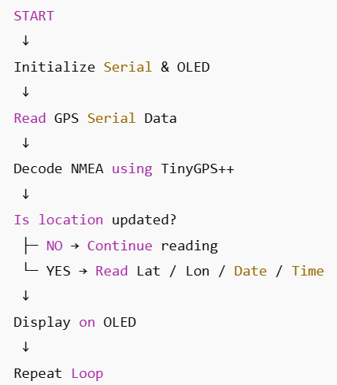
GPS Satellite-Based Position and Time Estimation
Program Flow
Flow of Operation

Slide 11
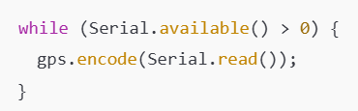
GPS Satellite-Based Position and Time Estimation
Code Highlights: GPS Data Decoding
GPS Serial Decoding
GPS transmits continuous NMEA messages
TinyGPS++ processes the incoming data stream
Continuous decoding is essential for valid updates

Slide 12
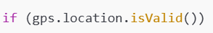
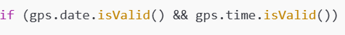
GPS Satellite-Based Position and Time Estimation
Code Highlights: Validity Checks
Location Validation
Ensures latitude and longitude values are trustworthy
Prevents display of invalid or incomplete GPS data
Date and Time Validation
Ensures GPS time information is valid
Avoids displaying incorrect timestamps

Slide 13
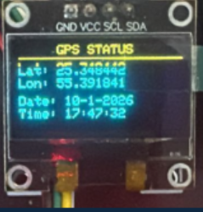
GPS Satellite-Based Position and Time Estimation
OLED Output Interpretation
Displayed Parameters
Lat Latitude in decimal degrees
Lon Longitude in decimal degrees
Date Date reported by GPS (UTC)
Time Time reported by GPS (UTC)
Observations
Indoor testing may delay Fix
Outdoor testing improves reliability

Slide 14
GPS Satellite-Based Position and Time Estimation
Experimental Procedure
Procedure
Place the robot outdoors or near a clear window
Power ON the GPS module
Allow sufficient time for cold start (3–5 minutes)
Observe latitude and longitude updates
Verify date and time consistency
Record initial fix time and coordinates

Slide 15
GPS Satellite-Based Position and Time Estimation
Result Interpretation
Expected Results
Latitude and longitude stabilize after GPS Fix
Date and UTC time update correctly
OLED refreshes smoothly with updated data
Serial monitor shows matching debug output
Observations
Indoor testing may delay Fix
Outdoor testing improves reliability

Slide 16
GPS Satellite-Based Position and Time Estimation
Practical Considerations
Important Notes
GPS accuracy depends on satellite visibility
Cold start requires patience
D0/D1 pins must be disconnected during program upload
GPS should be treated as a state-dependent sensor
Summary
GPS determines position using satellite signals
Latitude and longitude provide real-time location
GPS date and UTC time are independent of local clocks
Proper validation and testing are essential
This experiment forms the foundation for all GPS-based navigation tasks

Slide 17
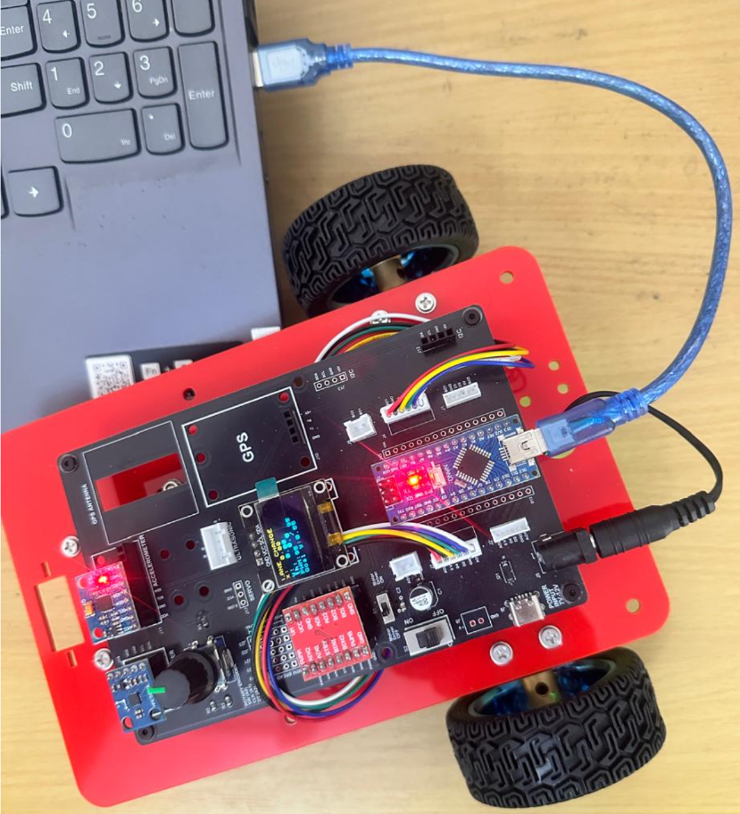
GPS Fix Quality and Accuracy
Critical Programming Setup
MANDATORY Switch Settings Before Uploading Code
Before connecting USB and uploading program:
“Motor Driver ON/OFF” Switch
⚠️ MUST BE SET TO: OFF
Why?
Prevents motors from running during code upload
Avoids car moving unexpectedly on desk
Protects USB connection from power surges

Slide 18
GPS Fix Quality and Accuracy
During Programming (Code Upload):
Step 1: Connect USB cable to computer
Step 2: Set Switch “Motor Driver ON/OFF” → OFF
Step 3: Set Switch “Battery ON/OFF ” → OFF ->for batter power
Step 4: Upload your the respective program
Step 5: Wait for "Upload Complete" message
Step 6: Disconnect USB cable
Before Testing (Running the Robot):
Step 1: Place robot on the ground. No obstacle as this test for basic movements
Step 2: Set Switch “Motor Driver ON/OFF” ->ON ( motor driver ON)
Step 3: Set Switch “Battery ON/OFF” → ON -> for batter power
Step 4: Monitor the Robot car-3 Movements & OLED , Monitior the functionality according to the program

Slide 19
Q&A
Invite Questions: Encourage the audience to ask questions for further clarification or discussion.

